Slide 1
Marketing Opportunities @ West Chester University
For SGA recognized clubs and organizations

Slide 2
University Policy for Advertising
The university has specific policies regarding advertising on campus, which can be found in The Ram’s Eye View. All advertisements must concur with the University civility code and must be supportive of the university’s mission. To ensure that the advertisement on campus informs the public, enhances the campus environment, and adheres to all University policies, student organizations must follow these procedures when they advertise their programs:

Slide 3
University Policy for Advertising - General
Advertisement depicting alcohol use, abuse, sale, or distribution is prohibited.
In accordance with the University's Civility Statement, advertisements must respect the human rights and personal dignity of individuals. Therefore, advertisements that demean others on the basis of race, lifestyle, religion, disability, national origin, or sexual orientation or gender are strictly prohibited. In addition, advertisement by West Chester University student organizations should be complementary to the mission of the University and adhere to community standards of civility and good taste.
The official West Chester University logo, seal, and Ram logo may not be used without permission from the Office of Publications, Printing and Editorial Services, located in 13/15 University Avenue, 610-436-2231.
Advertisements that will be going to external and/or off campus publics must have the prior approval of the Office of Public Relations and Marketing located in 13/15 University Avenue, 610-436-3383.
All advertisements must be removed from bulletin boards and other campus locations within 24 hours of the event.
All officially recognized student organizations at West Chester University are obliged to comply with University policies; therefore, violations of this "Advertising Policy" could jeopardize a student organization recognition status on campus.

Slide 4
Overview of Presentation
University Policies (just reviewed)
Indoor Advertising
Outdoor Advertising
Digital Signage
On Campus Publications
Tabling

Slide 5
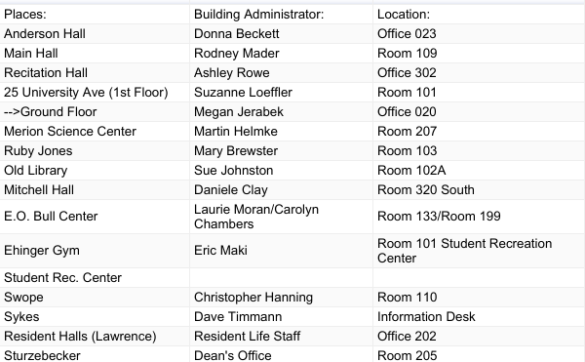
Indoor Advertising
Posting in buildings is only permitted on designated bulletin board space with approval. Advertisements posted on walls, doors etc. are immediately removed by the Custodial Services Department.

Slide 6
Outdoor Advertising
Advertising must be approved before being posted:
Banners may be hung outside of Sykes Union on the ramp and patio railings with permission from the Sykes Union Administrative staff.
Banners over Church St. at the corner of University Ave. need to be approved by the West Chester Borough Council since this is not University property. An application (available from the director of student leadership and involvement in 238 Sykes Union) must be filed 30 days in advance. Once the approval is granted, a copy of the approved permit, which includes a sketch of the design, must be submitted to the director of student leadership and involvement so arrangements with the University's maintenance department can be made to hang the banner.
No approval is needed to post advertisements on public gazebos (e.g., by Ruby Jones). Posters and signs are not permitted on the exterior or interior surfaces of the bus stop shelters except on bulletin boards mounted inside the shelter.
Advertisements are not permitted on garbage cans, benches, trees, and/or exterior walls or doors of buildings.
"Chalking" of sidewalks or any other surface is prohibited.
Signs on stakes placed on University grounds must be approved in advance by a Sykes Union administrator, who will coordinate placement of advertisements with the manager of Grounds Maintenance, Josh Braid.

Slide 7
On Campus Publications
The Quad
Weekly Student Newspaper distributed on Mondays in print and online. To advertise, email The Quad (QuadAdvertising@wcupa.edu).
WCUR - The Curve
West Chester University's Radio Station. To have an announcement read on air, complete this form located here: http://www.wcur.org/events_spreadtheword.html
WCU Weekly (WCUTV)
Weekly YouTube videos highlighting campus announcements and events. To advertise, email WCU Weekly (wcuweekly@wcupa.edu).
RamConnect
Student organizations and clubs are welcome to view and post events via the RamConnect online calendar.
SAC movie preview ads
If interested in showing your advertisement in the previews before SAC’s movie starts, contact the SAC’s movies coordinator.

Slide 8
On Campus Publications - Continued
Ram RoundUp
Managed by the student affairs division, Ram Roundup is a weekly email (sent every Wednesday to all-students) containing announcements and information about upcoming events and initiatives. Submit a Ram Roundup request here: https://wcupa.edu/_services/stu/forms/informationForStudents/.
Digital Signage
There are 30+ flat screen televisions located in buildings across campus which display slides/ads of events and campus announcements. Submit the Digital Signage Request Online Form to have your event flyer or ad displayed on the digital signage screens across campus.
Stall Seat Journal
To advertise in Stall Seat Journal, fill out the request form: https://www.wcupa.edu/_services/stu.inf/stallseatform/

Slide 9
Other areas of marketing
Table tents and banners in the Lawrence Center Dining Hall
If you want to post advertisements in the napkin holders in Sykes or Lawrence, email Campus Dining Services (wcudiningservices@wcupa.edu ). They handle advertising on a case by case basis depending on what the advertising is for. Generally, they use the napkin holders for their own advertising but they offer other areas of advertisement as well, such as social media and some of their advertising boards.
Mailboxes
Fliers can be placed in the student organization mailboxes in the Center for Student Involvement in Sykes Student Union.
West Chester University’s Social Media
If you would like your event promoted via WCU's main social media channels, please contact Melissa Rudolph (mrudolph@wcupa.edu). She can also help with establishing a social media presence.
If you publish a Facebook Event, please add "West Chester University of PA" as a co-host of the event.
Marketing Outside West Chester University
You may also contact the West Chester Borough Council or approach individual businesses for permission to advertise in their business.

Slide 10
Tabling
You can reserve a table in Lawrence Center, Sykes Student Union, and the lobby area of the Business and Public Management Center for advertising through tabling using 25live.
Go to https://25live.collegenet.com/wcupa/#home_calendar
Follow the instructions listed to sign in with your WCU credentials
After signing in, go to the “Event Wizard” and fill out the information regarding your event. Click “Next” once done.
Enter your expected audience count. If you are tabling, you will want to enter 2. Click “Next” once done this section.
Enter the event date and time and then click “Next,” if repeating click “Yes” and if tabling for one event, click “No.”
In the “Search by Location Name” box, enter Syk103 to search for tabling in Sykes, LAW184 for tabling in Lawrence, and BPC182 for tabling in the lobby of the Business Building.

Slide 11
References and more information
For a listing of ways to advertise a campus event, see the following link:
https://www.wcupa.edu/communications/advertising.aspx
For a listing of building administrators to obtain flyer approval, see the link below:
https://www.wcupa.edu/_services/STU/ramsEyeView/advertisingApproval.aspx
To access the University Program Planning Guide, see the link below:
https://www.wcupa.edu/_services/Stu.Syk/documents/ProgramPlanningGuide16-final.pdf
To access the Campus Advertising Policy, see the following link:
https://www.wcupa.edu/_services/STU/ramsEyeView/advertisingPolicy.aspx

