Slide 1
Center for Trans & Queer Advocacy
West Chester University

Slide 2
CTQA Mission and Values
Mission Statement:
The mission of the Center for Trans and Queer Advocacy is to create an environment where the intersectional experiences of trans and queer people are supported, celebrated, validated and affirmed.
Values:
Advocacy
Social Justice
Intersectionality
Wholistic Wellness

Slide 3
Meet the Staff
Professional Staff:
Tiffany Gray (she/her) Senior Director
Steven Feldman (he/they) Assistant Director
Soozie Davidson (they/them) Administrative Assistant
Chris McCullough (they/them) Graduate Assistant
We also have 7 Peer Educators who assist with programming, trainings, and social media for CTQA!

Slide 4
What we offer
Programs:
Ram I Ams
Queering the Conversation Series
Lavender Graduation
Queer Pride Day
Trainings:
Queer Basics
Trans Advocacy
Intersectionality in Practice
From Allyship to Advocacy

Slide 5
Trans and Non-binary Resources
Housing:
West Chester University is committed to exploring and open to providing safe campus housing for all students. Single occupancy housing is available in our traditional residence halls. Suite style housing is available in our South Campus Apartments and University Student Housing residence halls.
Bathrooms:
West Chester University has identified a number of single occupancy restrooms on campus. Visit the CTQA website for a list of gender-inclusive restrooms around campus!

Slide 6
We can offer additional support for:
Folks who are in the process of coming out and/or transitioning
Helping students navigate changing one’s name and pronouns
Discussing how to communicate name/pronoun changes with your professors
Advocating on behalf of LGBTQIA+ students, faculty, and staff around campus
Providing space both physically and virtually for folks to come together and build community
To set up an individual meeting with a member of our staff, feel free to email or call us!

Slide 7
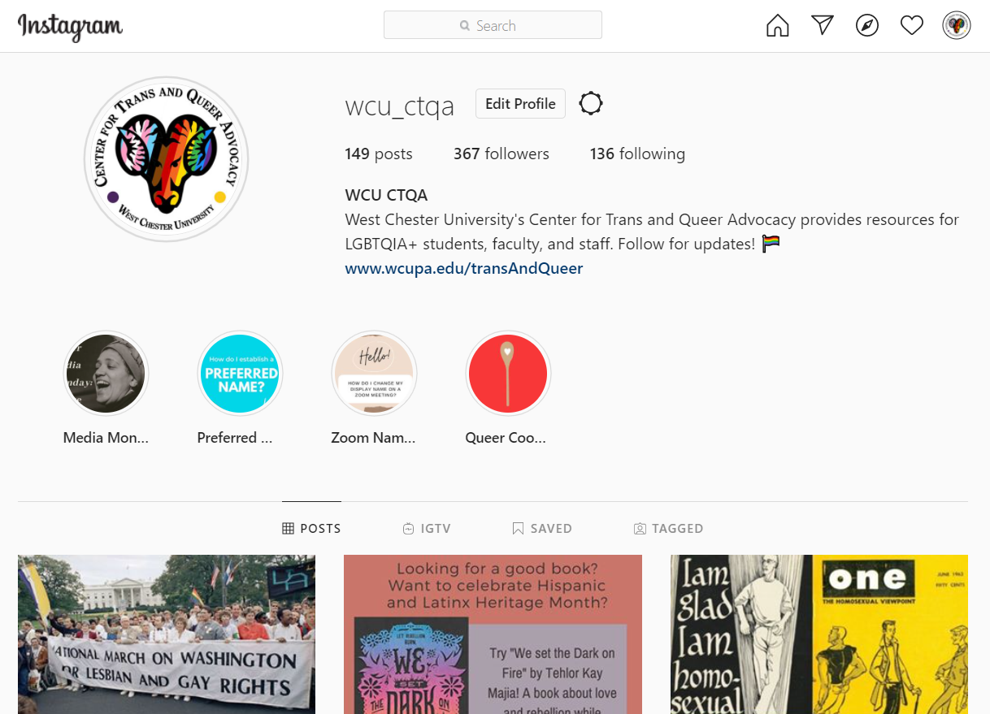
Instagram Demos

Slide 8
Sexuality and Gender Alliance (SAGA)
SAGA is a social, student-run club that offers friendship, education, discussion, resources, and often snacks for the LGBTQA+ community and it’s allies. We meet every Monday from 4:30-5:30pm in Sykes 10A during the fall and spring semesters.
If you are a trans and/or queer person of color, check out our break-off group, Shades of the Rainbow. We also have another separate group, T-Time, strictly for the trans and non-binary community.

Slide 9
Where to find us
We are located in the Sykes Student Union, Room 250.
We are also active on social media! Find us @wcu_ctqa
Register for our upcoming programs and trainings on RamConnect at ramconnect.wcupa.edu

Slide 10
Thank you!
Email: TransAndQueer@wcupa.edu
Phone: 610-436-3147

