Slide 1
College of the Sciences and Mathematics
Student Recognition Ceremony
And Poster Reception 2019

Slide 2
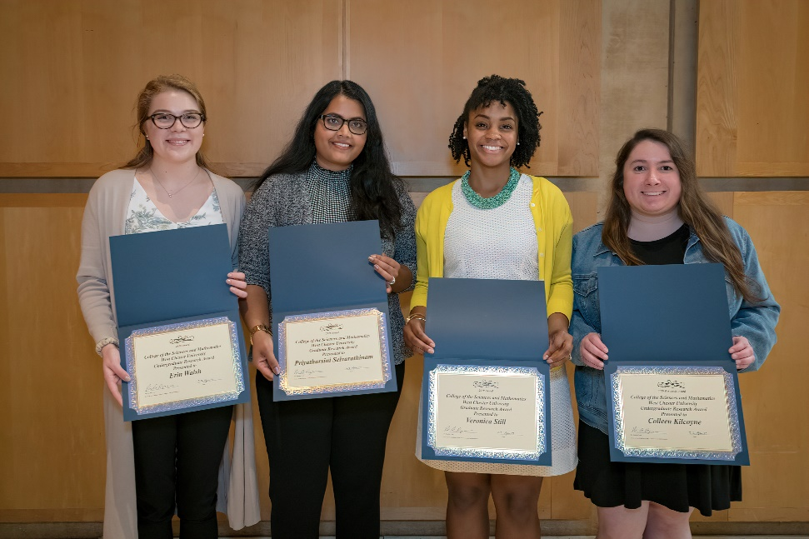
CSM 2019 Research Award Winners
Pictured: Erin Walsh, Priyatharsini Selvarathinam, Veronica Still & Colleen Kilcoyne
Not Pictured: Abbas Husain, Jaide Wible, Angela Zaccone, Dena Elansari, Hannah Crespy, Kelly Daudert, Brooke Miller, Caroline Guzi, Kelly Bradley, Kelsey Blum & Michael Powers
Notes:
Vernon intro slides (2mins)

Slide 3
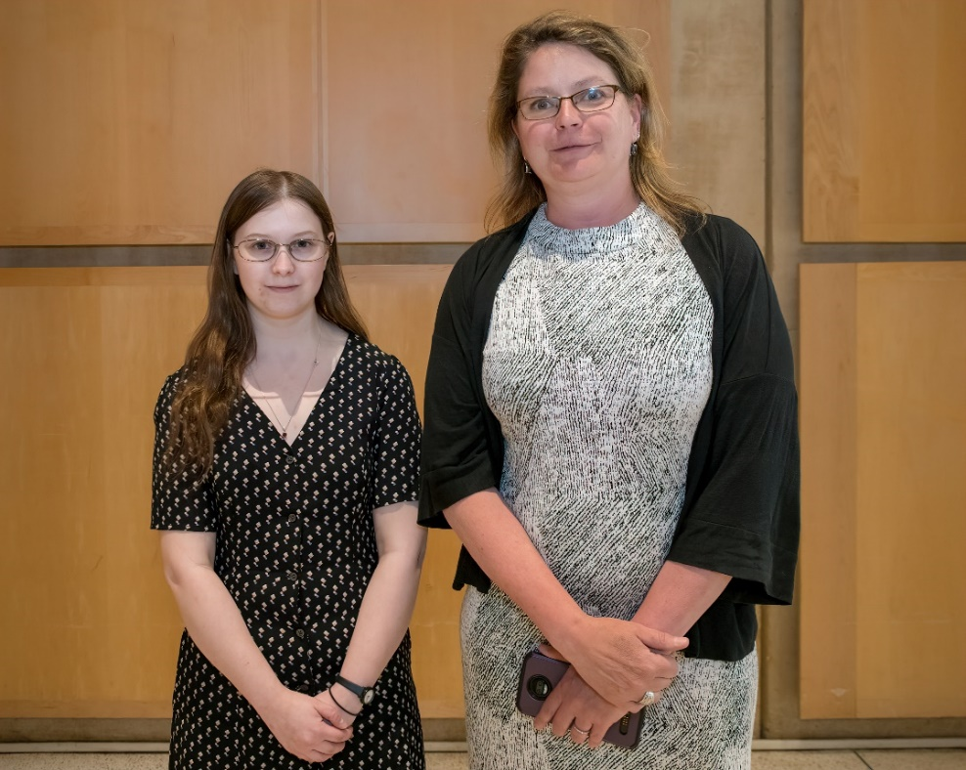
Anthropology 2019 Award Winner
Dr. Heather Wholey & Emily Pepper
Notes:
Vernon intro slides (2mins)

Slide 4
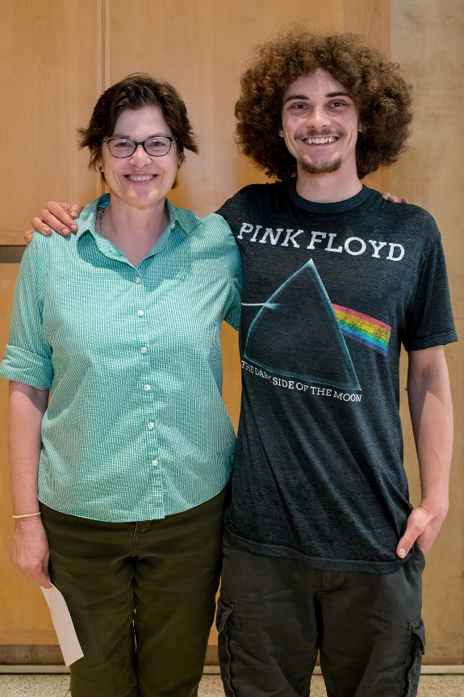
Sociology 2019 Award Winner
Dr. Jacqueline Zalewski & Andrew Bathemess
Notes:
Vernon intro slides (2mins)

Slide 5
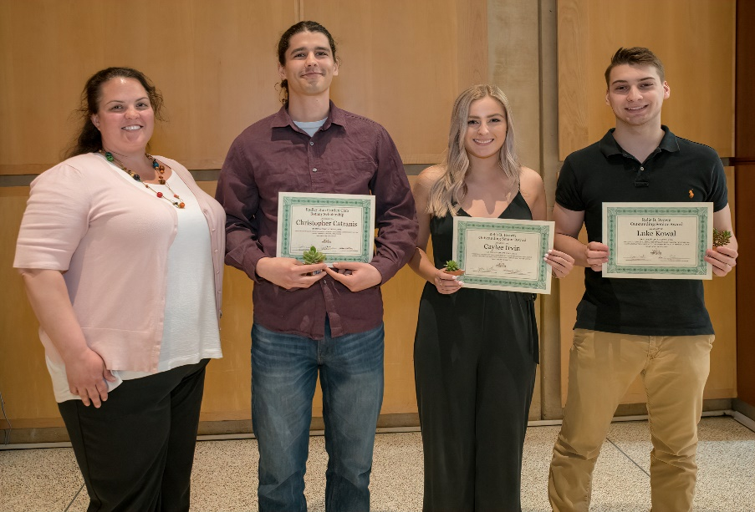
Biology 2019 Award Winners
Pictured: Dr. Jennifer Chandler & Christopher Catranis, Caylee Irvin & Luke Kowal
Not Pictured: Maribeth Beatty, Aamir Amanullah, Madison James & Kaelyn Cooper
Notes:
Vernon intro slides (2mins)

Slide 6
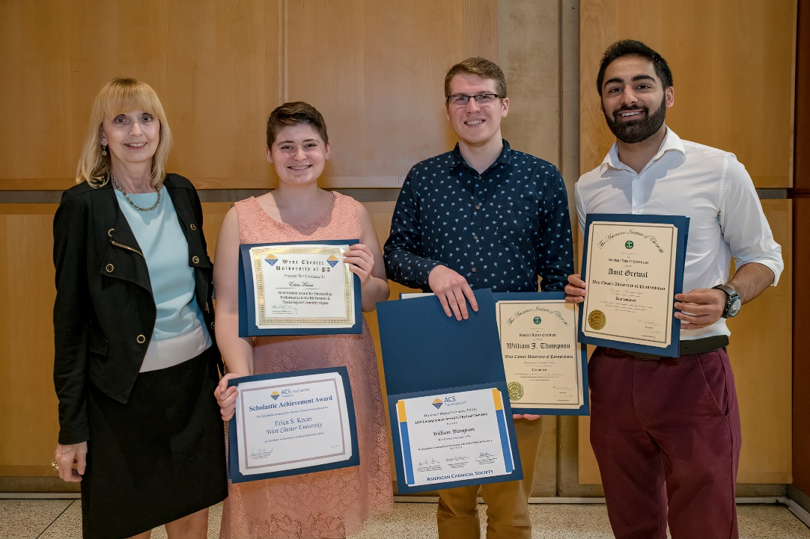
Chemistry 2019 Award Winners
Pictured: Dr. Melissa Cichowicz & Erica Knorr, William Thompson & Amit Grewal
Not Pictured: Summer Keefer & Annette Krzyanski
Notes:
Vernon intro slides (2mins)

Slide 7
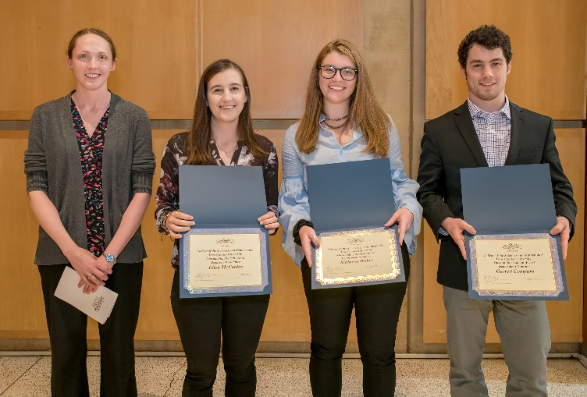
CSM 2019 Outstanding Student Award Winners
Pictured: Dr. Julie Wiest & Nominees: Ellen McCauley, Kathleen Weber & Garrett Compton
Not Pictured: Dominica DeFelice
Outstanding Student Award Winner: Sapana Gupta
Notes:
Vernon intro slides (2mins)

Slide 8
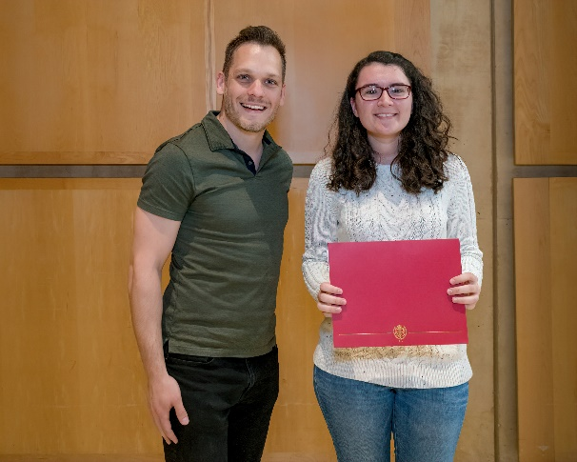
Computer Science 2019 Award Winners
Pictured: Dr. Richard Burns & Brittney Walsh-Piwowarski
Notes:
Vernon intro slides (2mins)

Slide 9
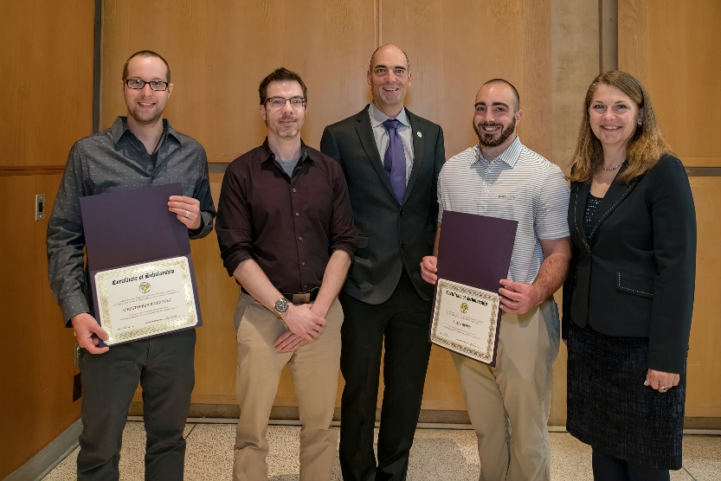
Earth & Space Sciences 2019 Award Winners
Pictured: Dr. Joby Hilliker & Dr. Daria Nikitina with Christopher Rodriguez, Tripp Fischer & Lukas Berry
Not Pictured: Abraham Johnson, Jacklyn Clark, Abigail Keebler, Michael Powers, Brian Leible & Matthew McDonald
Notes:
Vernon intro slides (2mins)

Slide 10
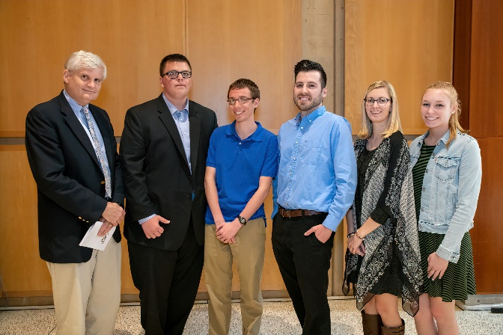
Mathematics 2019 Award Winners
Pictured: Dr. Peter Glidden & Brandon Edwards, Keith Hazen, Joe Sobieski, Jennifer Ciccotosto & Sarah Adcock Not Pictured: R. Hunter Langel, Kelly Schmoock, Katie Deegan, Tyler Prehl, Jeremiah Budgeon, Brandon Barker, Austin Carlson, Mitchell Henderson, Kaitlyn Cannon, Patrick Corrigan, Caroline Krusen, Sarah Haff, Tyler Lonergan, Caitlin Oswald, Kelly Pruitt, Patrick Murphy, Michael Pol, Jialai Chen, Yuping Zhang, Dana Heleniak, Robert Clark, Sean Gould, David Nichols, Alexandra Sonn, Anna Dyska, Paige Espenshade
Notes:
Vernon intro slides (2mins)

Slide 11
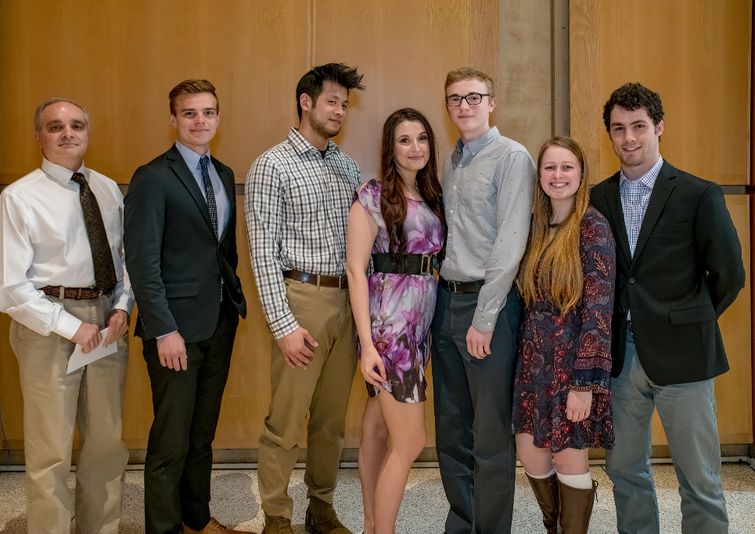
Physics and Engineering 2019 Award Winners
Pictured: Dr. Anthony Nicastro & Joseph Backowski, Jiahaw Fu, Valerie Woolaghan, Alex Lowry, Elizabeth Pedlow & Garrett Compton – Not Pictured: Matt Penecale, Stephen Dages, Anna Dyska, Kelsey Ortiz, Sequoyah Walters & Gina Dippolito
Notes:
Vernon intro slides (2mins)

Slide 12
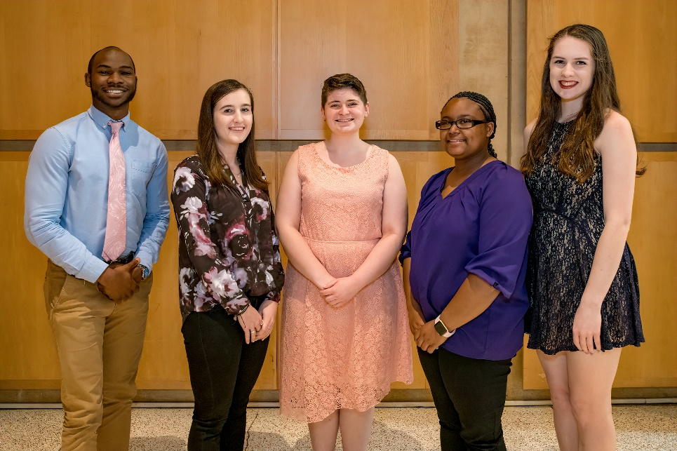
CSM 2019 Award Winners
Pictured: Demetrius Woodard, Ellen McCauley, Erica Knorr, Allena McCloud & Kathleen Schultz
Notes:
Vernon intro slides (2mins)

Slide 13
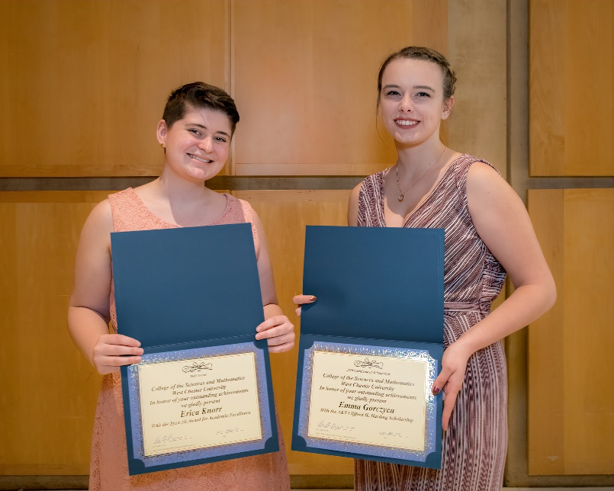
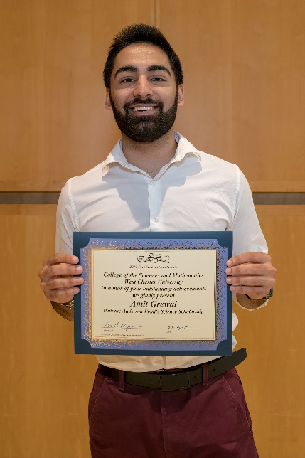
CSM 2019 Award Winners
Pictured: Erica Knorr, Emma Gorczyca & Amit Grewal – Not Pictured: Alyssa Beley, Blake Kerstetter, Veronica Muir, Olivia Kimber, Samantha Bouton, Anna Dyska, Katherine Fisher, Tyler Lonergan, Jacob Mann, Heidi McCollester, Melissa Morgan, Benjamin Popp, Kelly Schmoock, Maya Sengha, Juah Toe
Notes:
Vernon intro slides (2mins)

Slide 14
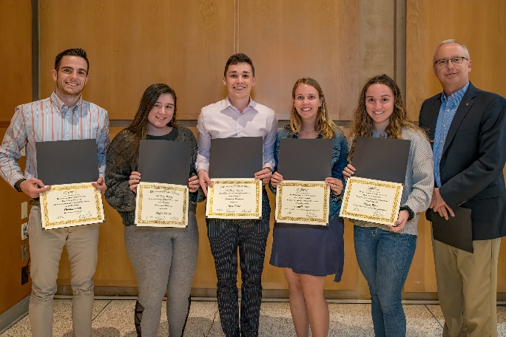
Political Science 2019 Award Winners
Pictured: Dr. Peter Loedel with Thomas Lewis, Kayla DiPaolo, Luke Kisiel, Danielle Sinn & Megan Shaw – Not Pictured: Kathleen Weber, Brianna Daley, & Maeve King
Notes:
Vernon intro slides (2mins)

Slide 15
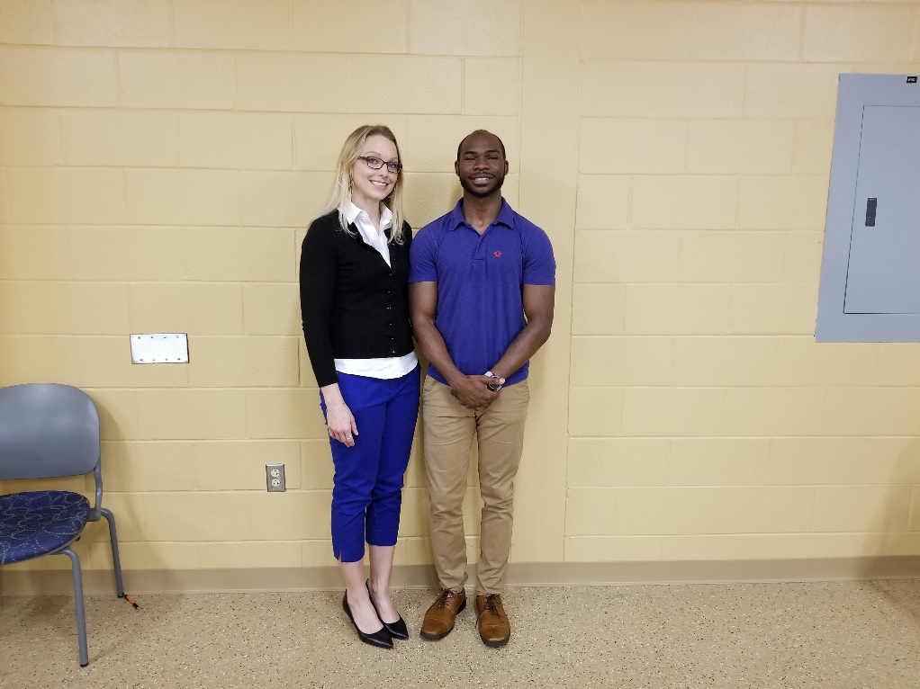
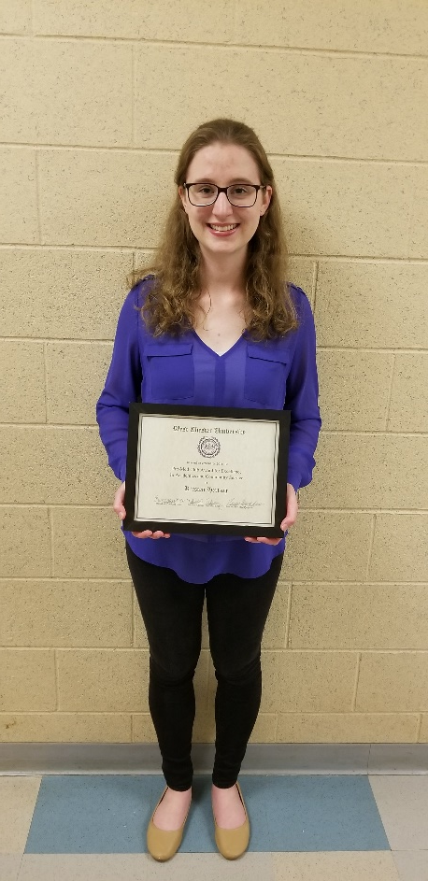
Pre Med 2019 Award Winners
Pictured: Dr. Teresa Donze-Reiner & Demetrius Woodard - Kirsten Hertzog
Notes:
Vernon intro slides (2mins)

Slide 16
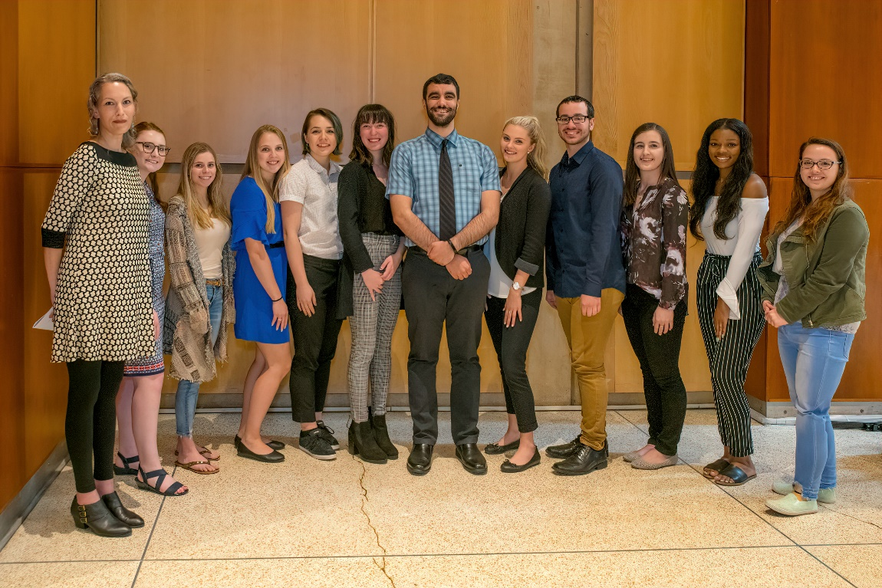
Psychology 2019 Award Winners
Pictured: Dr. Lia O’Brien & Kristen Ohl, Amanda Indictor, Jacquelyn Redmond, Kateri Sloat, Emma Shipley, Mario Garcia, Joyce Pour-Azar, Jossian Ramos Beltran, Ellen McCauley, Tamera Goode, & Colleen Sincavage
Notes:
Vernon intro slides (2mins)

Slide 17
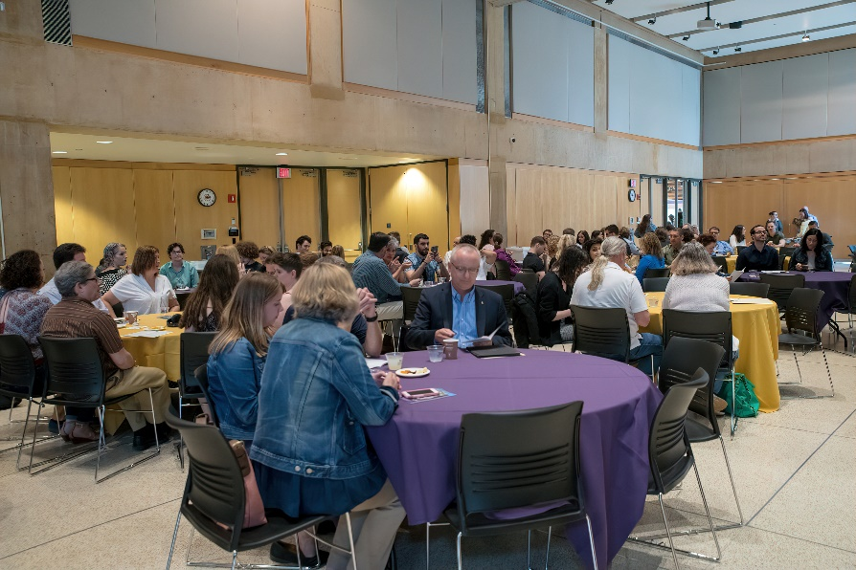
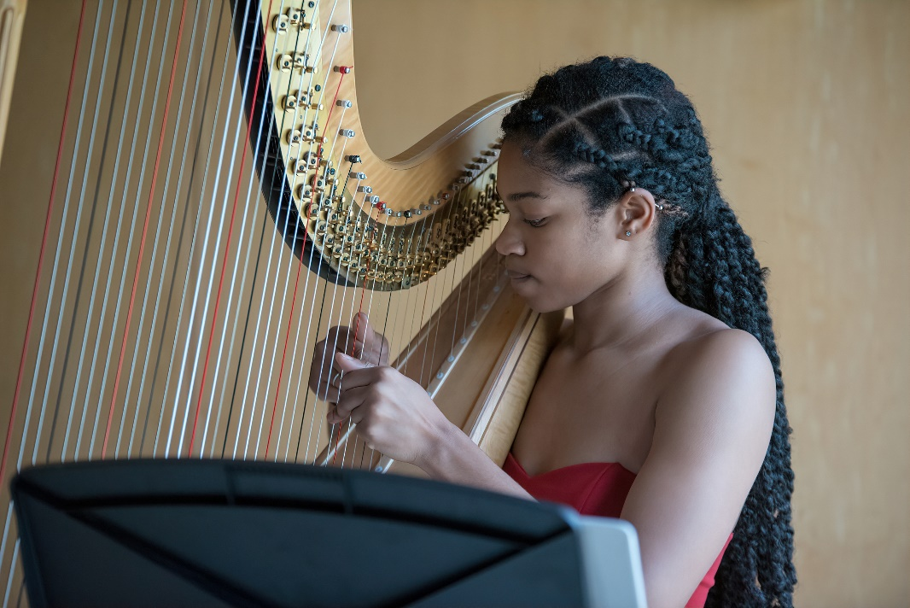
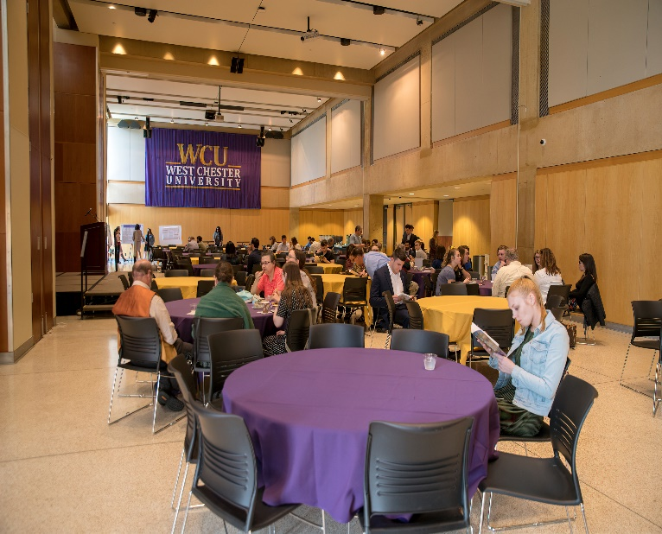
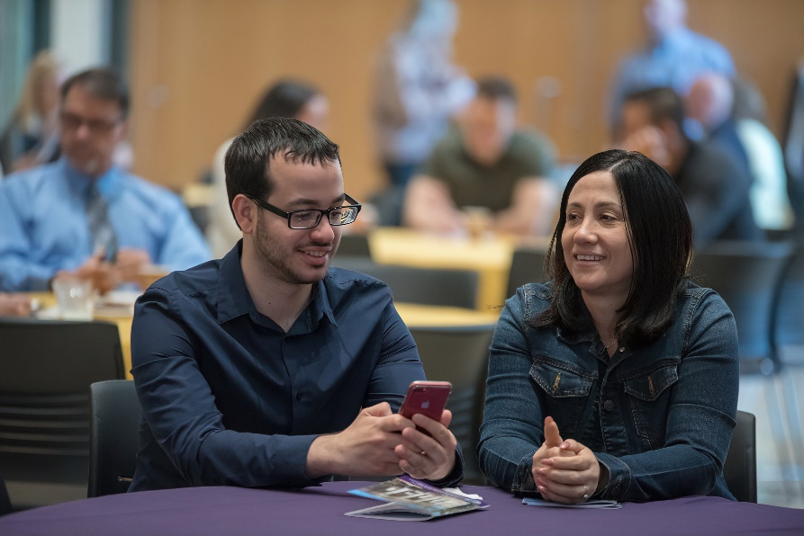
Niara Geiger – CSM Student/Harpist
Notes:
Vernon intro slides (2mins)

Slide 18
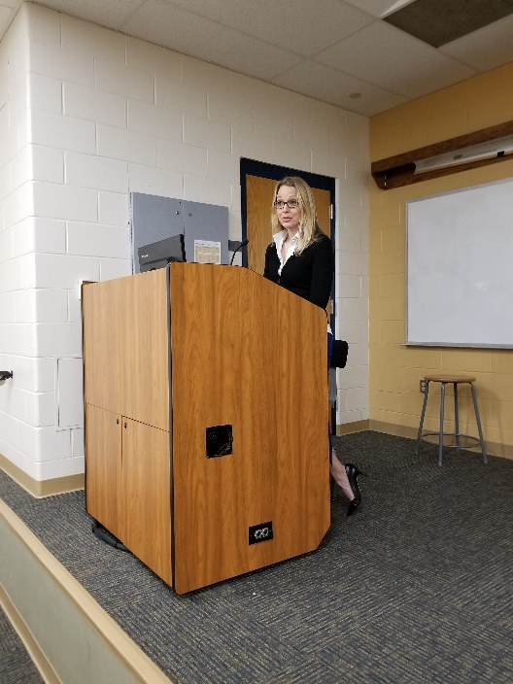
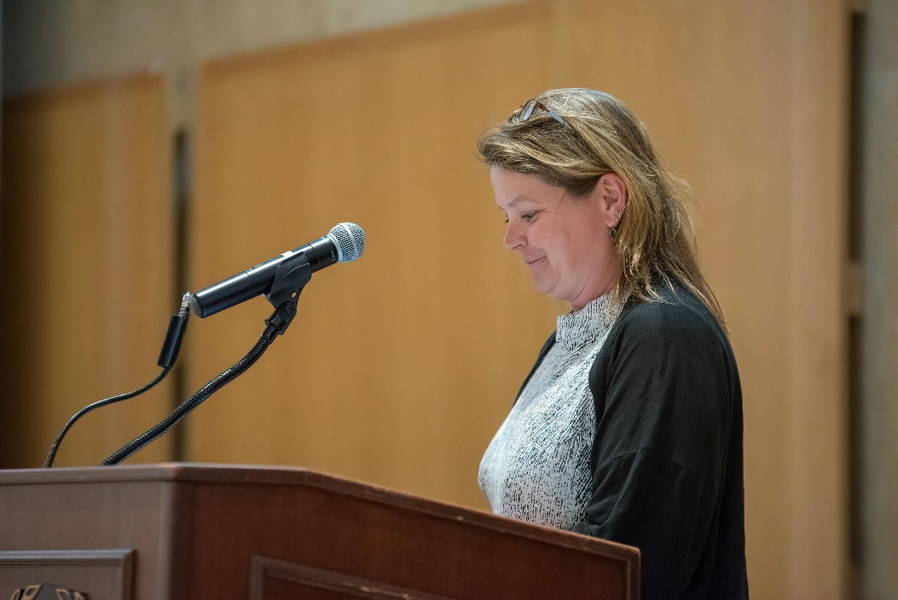
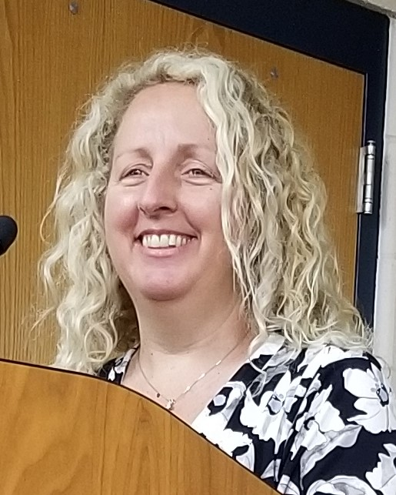
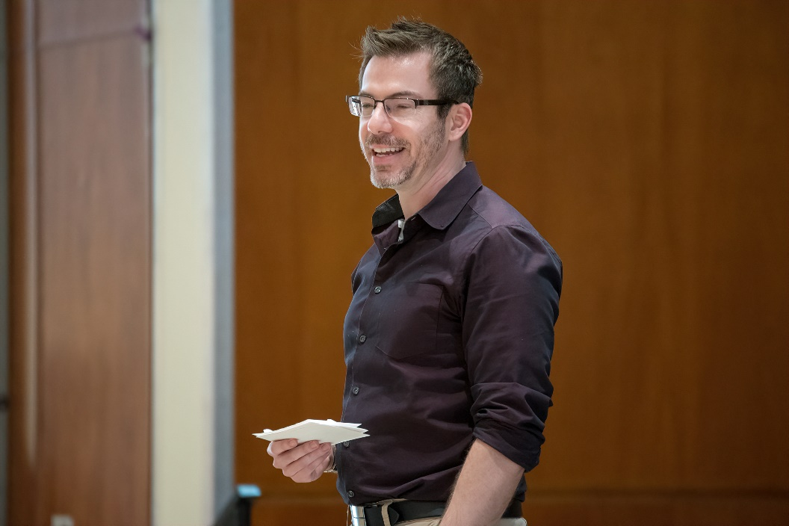
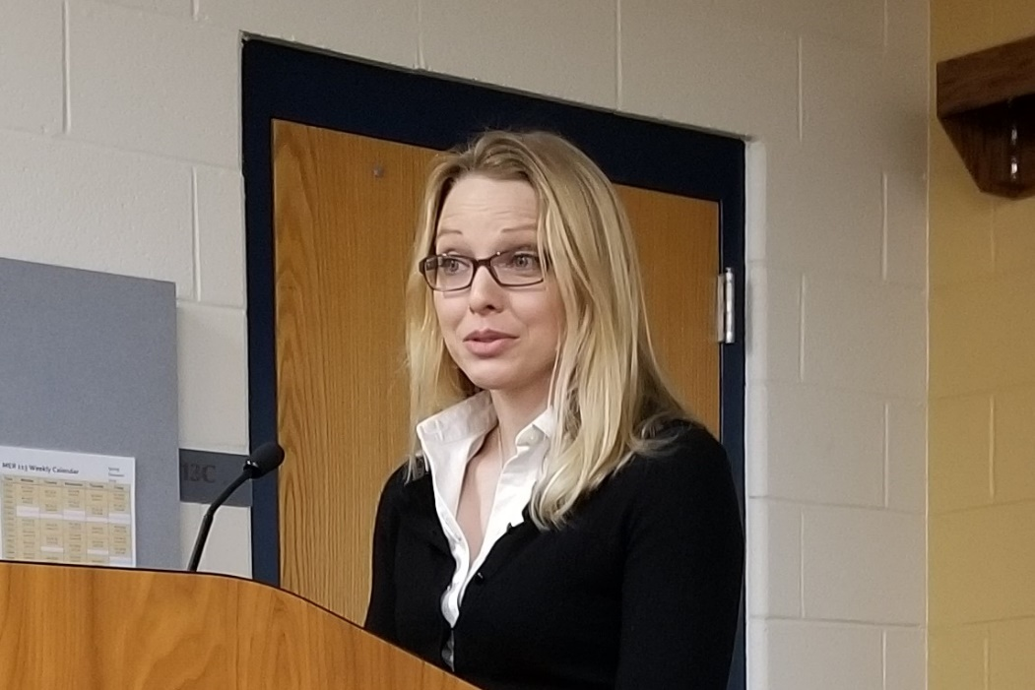
Dr. Lisa Marano
Faculty Associate
for Student Success
Notes:
Vernon intro slides (2mins)

Slide 19
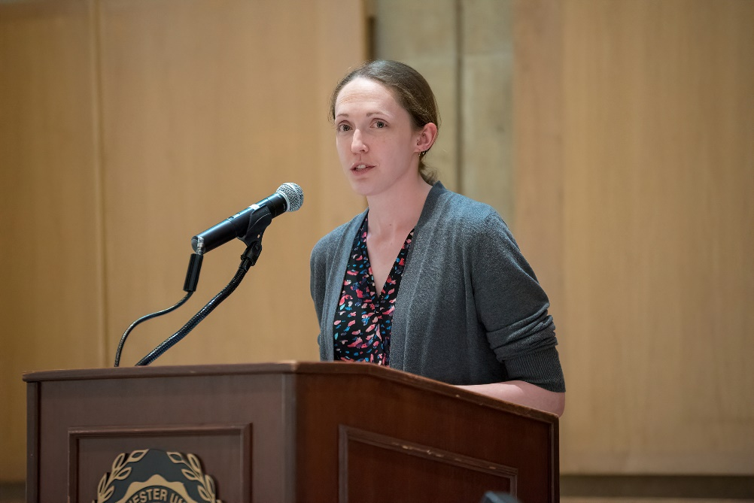
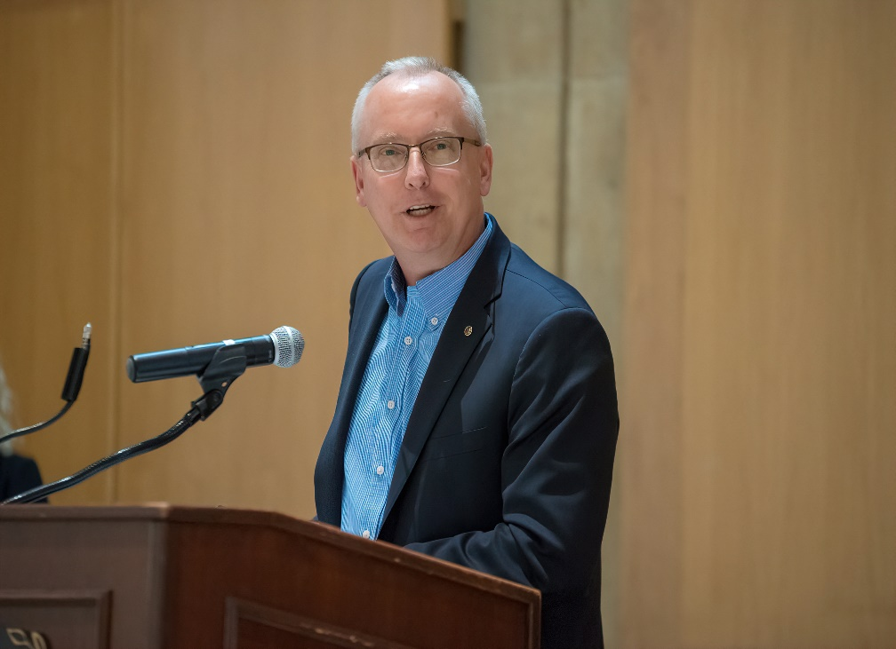
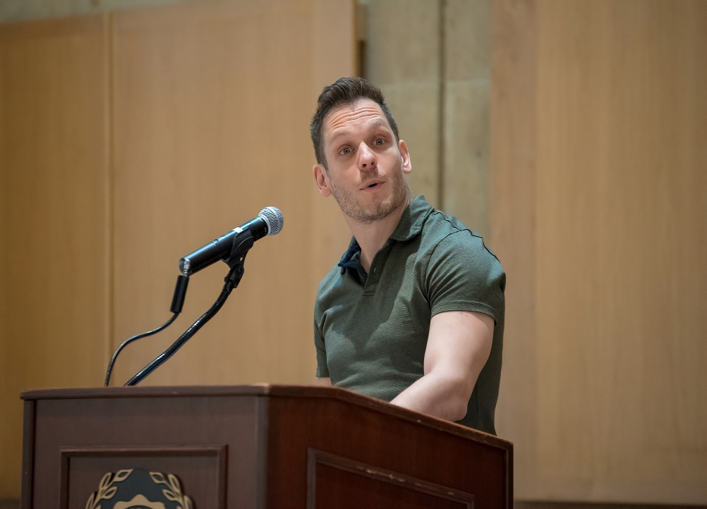
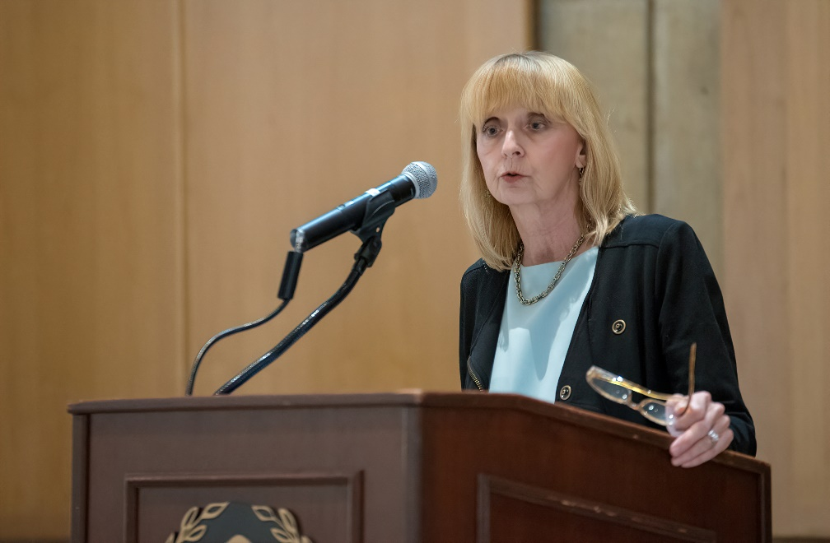
Dr. Vishal Shah
Associate Dean of the College of the Sciences and Mathematics
Notes:
Vernon intro slides (2mins)

Slide 20
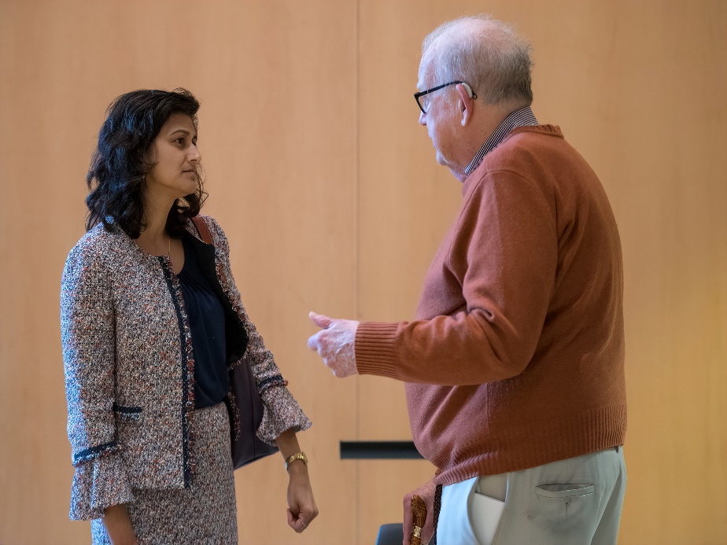
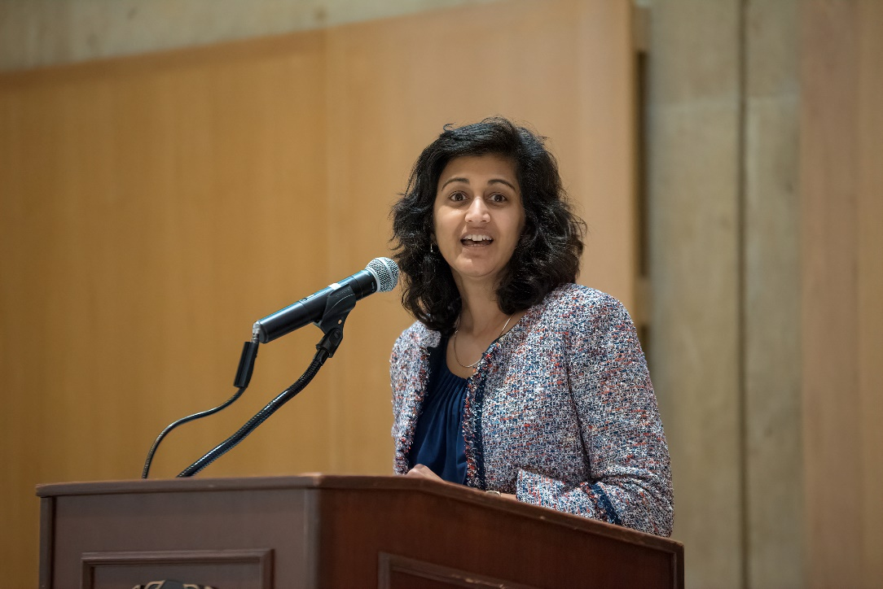
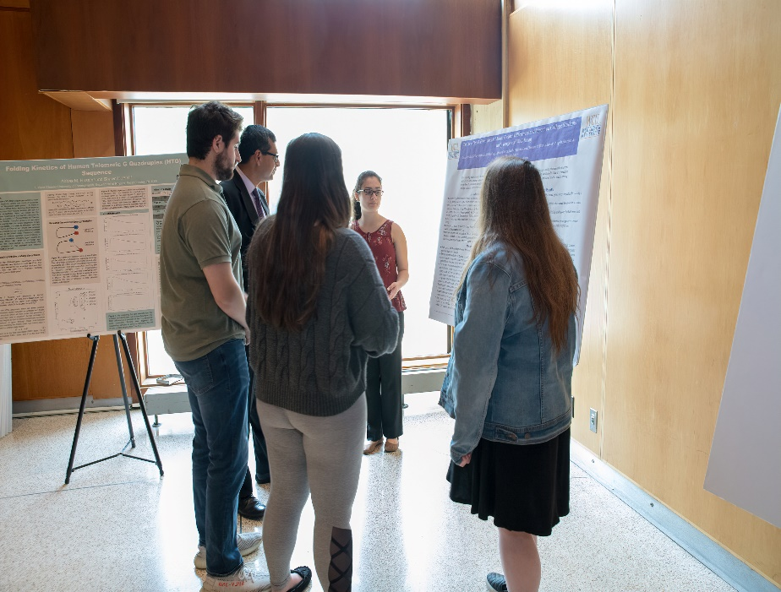
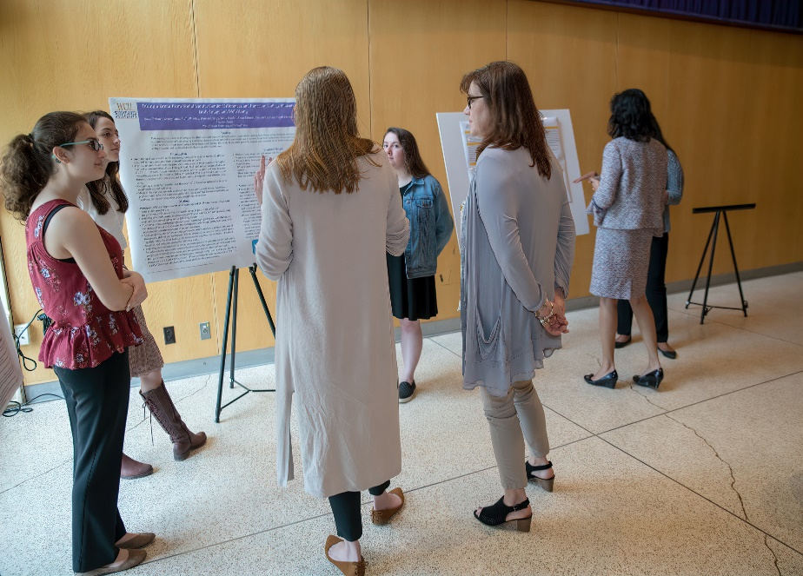
Dr. Radha Pyati
Dean of the College of the Sciences and Mathematics
Notes:
Vernon intro slides (2mins)

